Slide 1
2 most hot topics on NIPS 2016?

Slide 2
2 most hot topics on NIPS 2016
Reinforcement Learning
Generative models

Slide 3
Generative Models. Why?

Slide 4
Generative Models. Why?
What I cannot create, I do not understand.

Slide 5
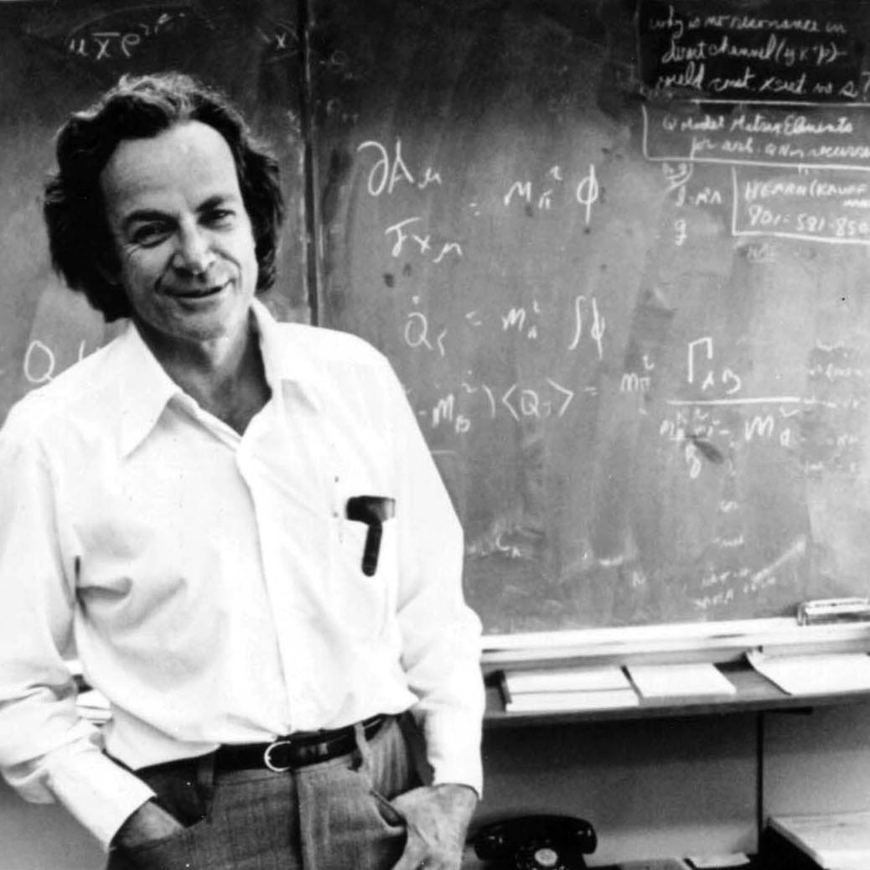
Generative Models. Why?
What I cannot create, I do not understand.
Richard Feynman

Slide 6
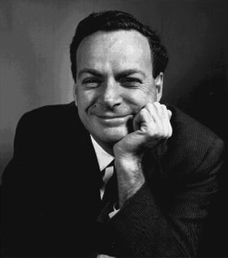
Generative Models. Why?
What I cannot create, I do not understand.
Richard Feynman

Slide 7
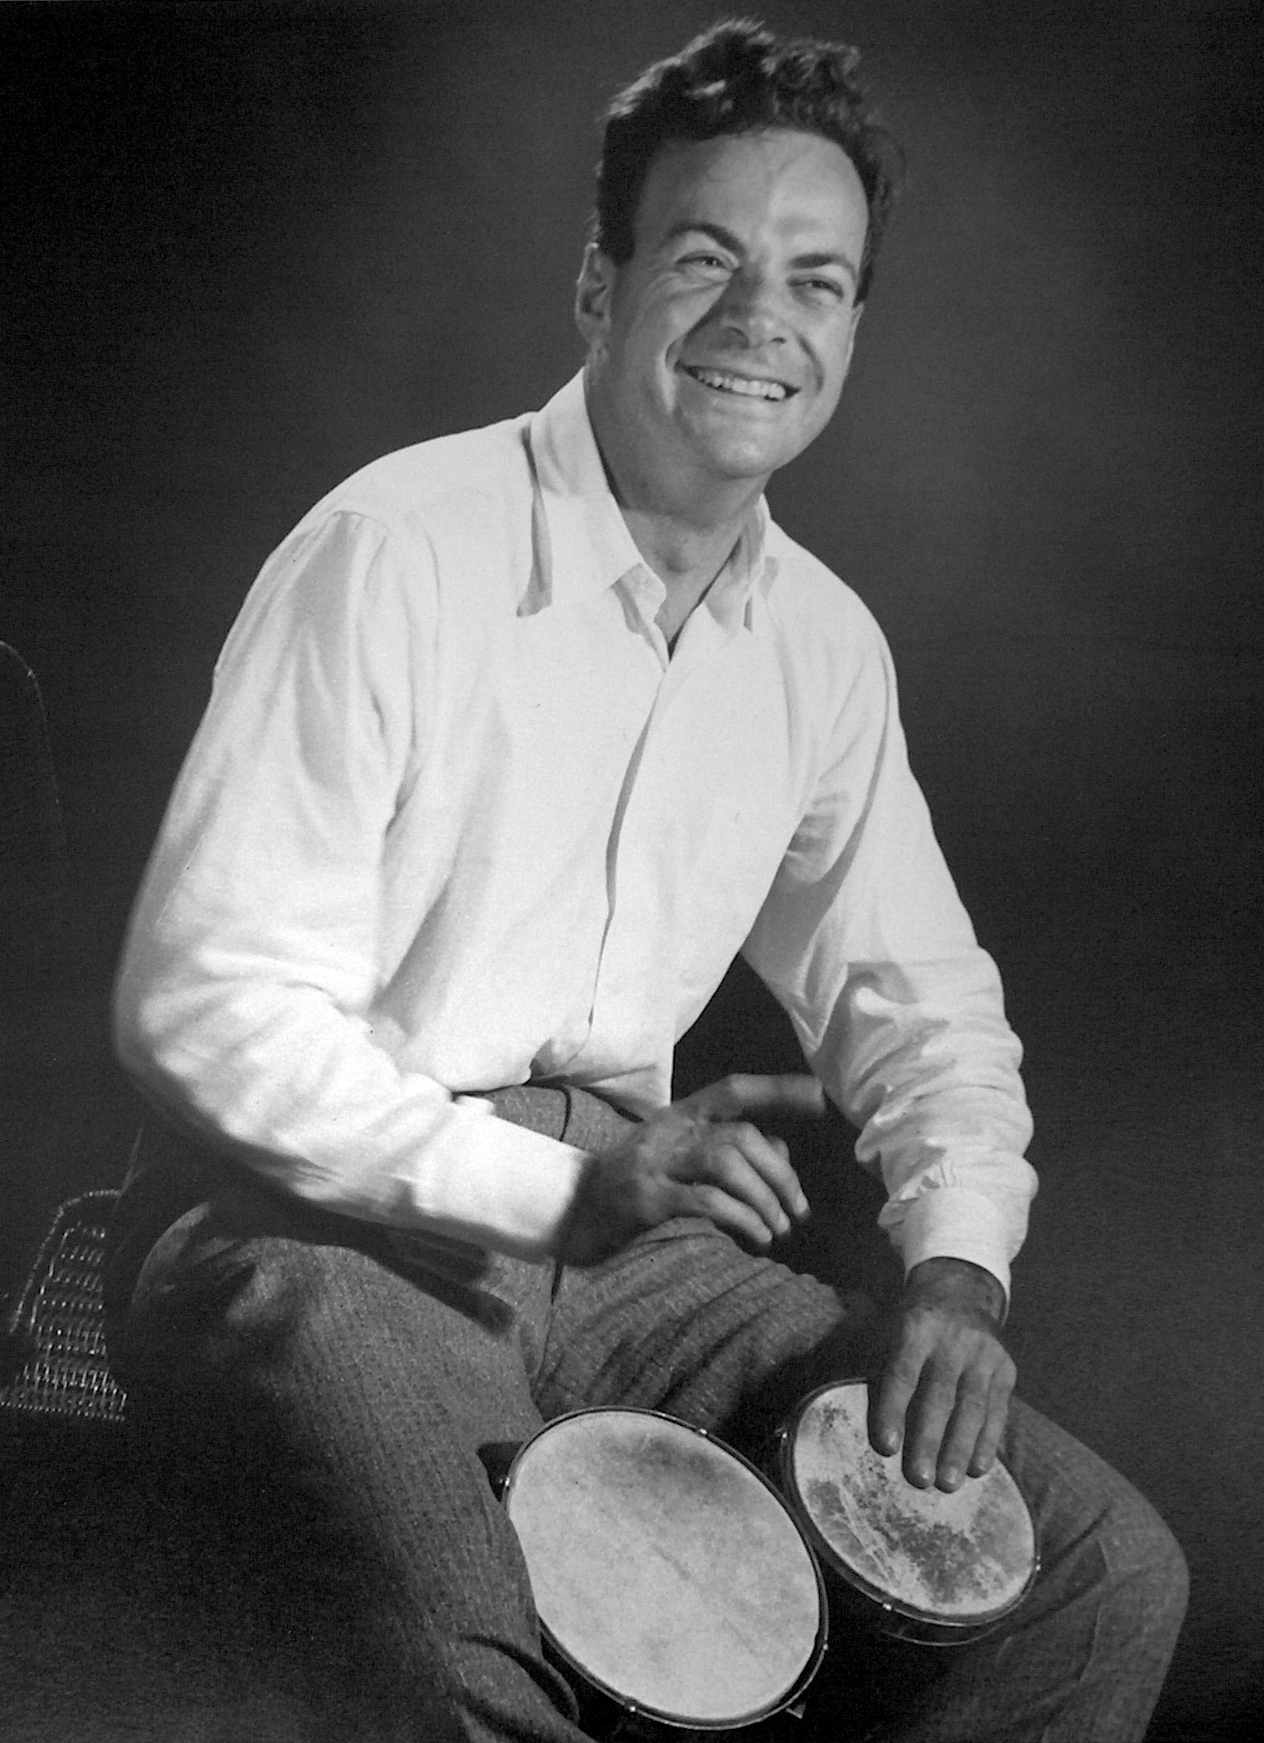
Generative Models. Why?

Slide 8
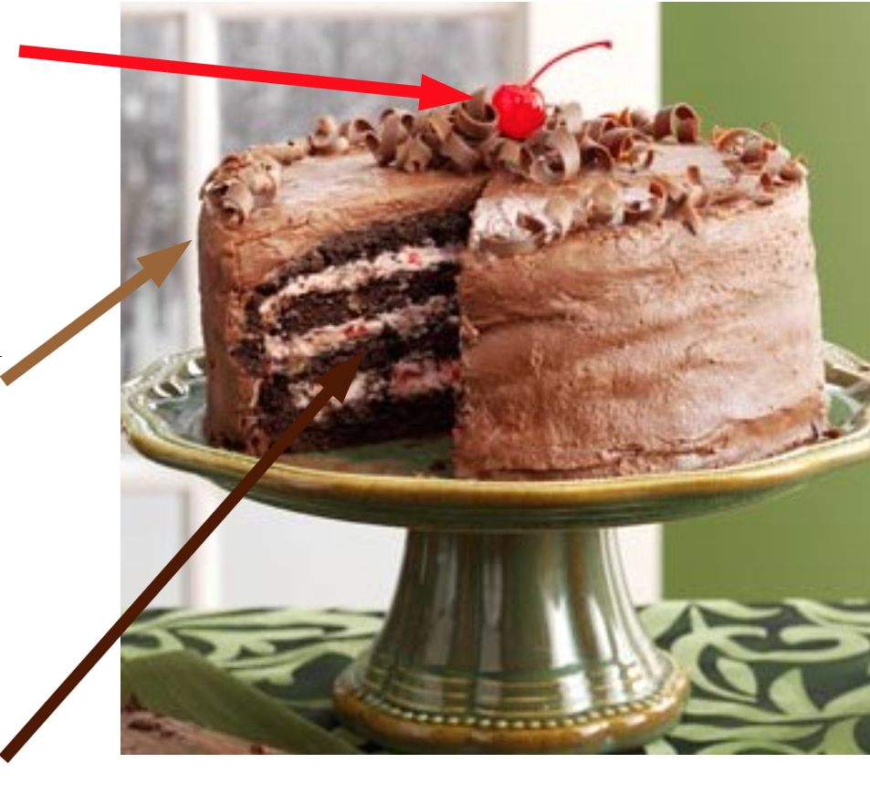
AI Cake
Reinforcement Learning
Supervised Learning
Unsupervised Learning

Slide 9
Why?
Most of the data is unsupervised
Humans learn in an unsupervised way

Slide 10
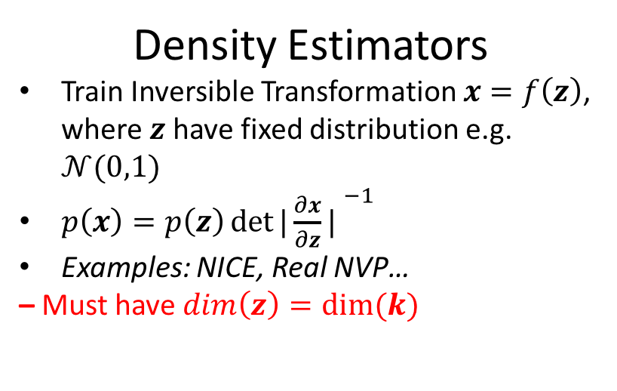
Generative Models of Images
Density Estimators
Train Inversible Transformation $x=f\left(z\right)$, where $z$ have fixed distribution e.g. $𝒩(0,1)$
$p\left(x\right)=p\left(z\right){det⁡|{\frac{∂x}{∂z}\text{|} }}^{−1}$
Examples: NICE, Real NVP…
– Must have $dim\left(z\right)=dim⁡(k)$
Variational Autoencoders
Based on approximate Bayesian Inference
Examples: VAE, DRAW…
– Currently cannot achieve good samples quality (blurry samples)
GANs
Based on adversarial training
Examples: GAN, InfoGAN, StackGAN …
– Tricky to train
– Tricky to evaluate

Slide 11
Generative Models of Images
Density Estimators
Train Inversible Transformation $x=f\left(z\right)$, where $z$ have fixed distribution e.g. $𝒩(0,1)$
$p\left(x\right)=p\left(z\right){det⁡|{\frac{∂x}{∂z}\text{|} }}^{−1}$
Examples: NICE, Real NVP…
– Must have $dim\left(z\right)=dim⁡(k)$
Variational Autoencoders
Based on approximate Bayesian Inference
Examples: VAE, DRAW…
– Currently cannot achieve good samples quality (blurry samples)
GANs
Based on adversarial training
Examples: GAN, InfoGAN, StackGAN …
– Tricky to train
– Tricky to evaluate

Slide 12
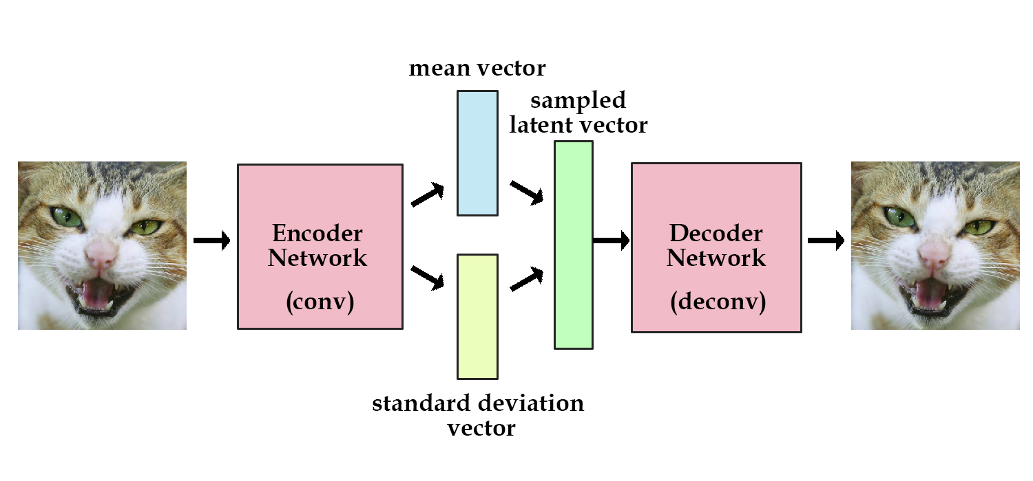
VAE – Variational AutoEncoder

Slide 13
VAE = Variational Autoencoder
Why variational?

Slide 14
VAE = Variational Autoencoder
Why variational?
Variational inference!

Slide 15
Bayesian ML in a nutshell

Slide 16
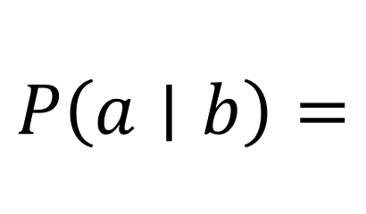
Recall Bayes formula
$$P\left(a∣b\right)=$$

Slide 17
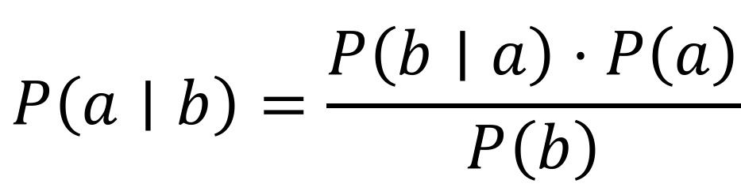
Recall Bayes formula
$$P\left(a∣b\right)=\frac{P\left(b∣a\right)⋅P\left(a\right)}{P\left(b\right)}$$

Slide 18
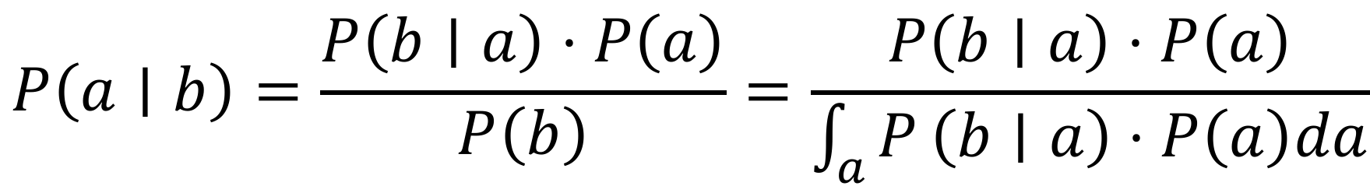
Recall Bayes formula
$$P\left(a∣b\right)=\frac{P\left(b∣a\right)⋅P\left(a\right)}{P\left(b\right)}=\frac{P\left(b∣a\right)⋅P\left(a\right)}{\int_{a}{P}\left(b∣a\right)⋅P\left(a\right)da}$$

Slide 19
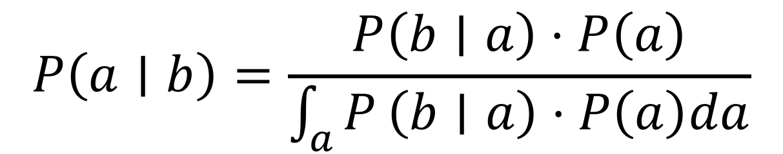
Recall Bayes formula
$$P\left(a∣b\right)=\frac{P\left(b∣a\right)⋅P\left(a\right)}{\int_{a}{P}\left(b∣a\right)⋅P\left(a\right)da}$$

Slide 20
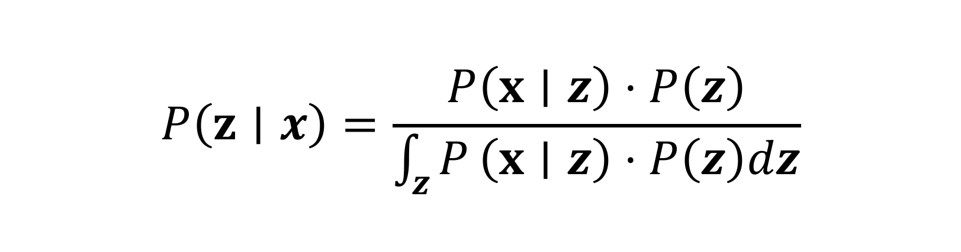
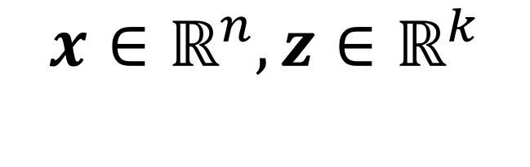
Recall Bayes formula
$$P\left(z∣x\right)=\frac{P\left(x∣z\right)⋅P\left(z\right)}{\int_{z}{P}\left(x∣z\right)⋅P\left(z\right)dz}$$
Holds when
$$x∈ℝ^{n}, z∈ℝ^{k}$$

Slide 21
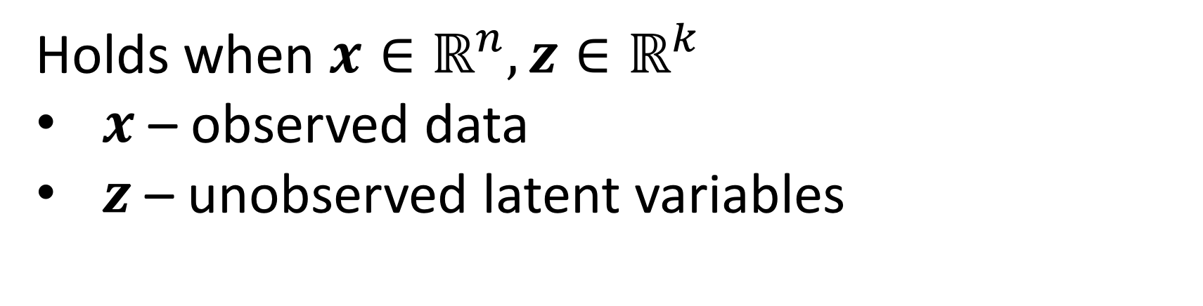
Recall Bayes formula
$$P\left(z∣x\right)=\frac{P\left(x∣z\right)⋅P\left(z\right)}{\int_{z}{P}\left(x∣z\right)⋅P\left(z\right)dz}$$
Holds when $x∈ℝ^{n}, z∈ℝ^{k}$
$x$ – observed data
$z$ – unobserved latent variables

Slide 22
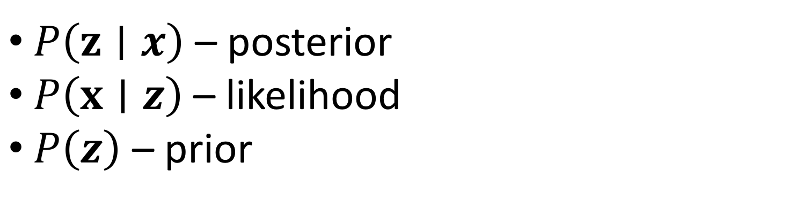
Recall Bayes formula
$$P\left(z∣x\right)=\frac{P\left(x∣z\right)⋅P\left(z\right)}{\int_{z}{P}\left(x∣z\right)⋅P\left(z\right)dz}$$
$P\left(z∣x\right)$ – posterior
$P\left(x∣z\right)$ – likelihood
$P\left(z\right)$ – prior

Slide 23
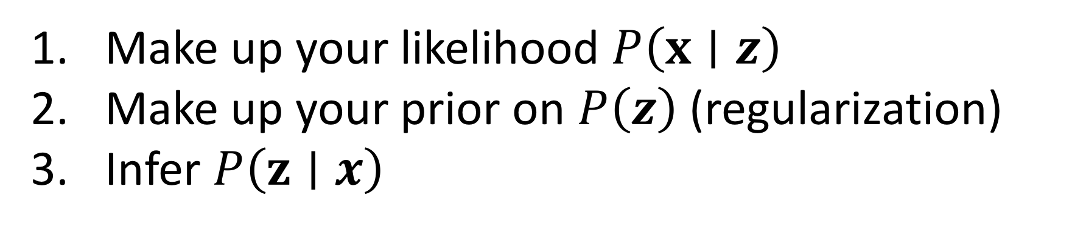
How to be Bayesian in 3(4) easy steps:
Make up your likelihood $P\left(x∣z\right)$
Make up your prior on $P\left(z\right)$ (regularization)
Infer $P\left(z∣x\right)$

Slide 24
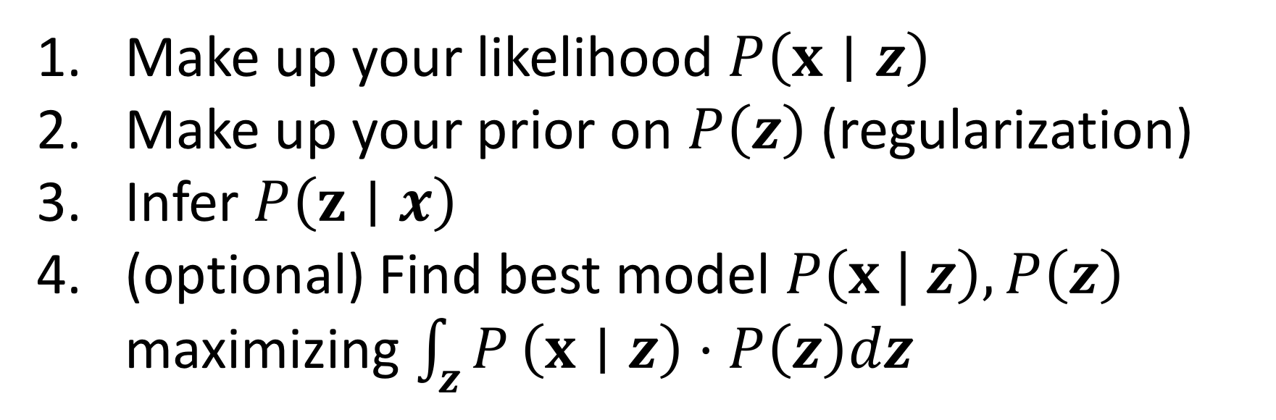
How to be Bayesian in 3(4) easy steps:
Make up your likelihood $P\left(x∣z\right)$
Make up your prior on $P\left(z\right)$ (regularization)
Infer $P\left(z∣x\right)$
(optional) Find best model $P\left(x | z\right), P\left(z\right)$ maximizing $\int_{z}{P}\left(x∣z\right)⋅P\left(z\right)dz$

Slide 25

How to be Bayesian in 3(4) easy steps:
Make up your likelihood $P\left(x∣z\right)$
Make up your prior on $P\left(z\right)$ (regularization)
Infer $P\left(z∣x\right)$
(optional) Find best model $P\left(x | z\right), P\left(z\right)$ maximizing $\int_{z}{P}\left(x∣z\right)⋅P\left(z\right)dz$

Slide 26
Recall Bayes formula
$$P\left(z∣x\right)=\frac{P\left(x∣z\right)⋅P\left(z\right)}{\int_{z}{P}\left(x∣z\right)⋅P\left(z\right)dz}$$
What about denominator $\int_{z}{P}\left(x∣z\right)⋅P\left(z\right)dz$ ?

Slide 27
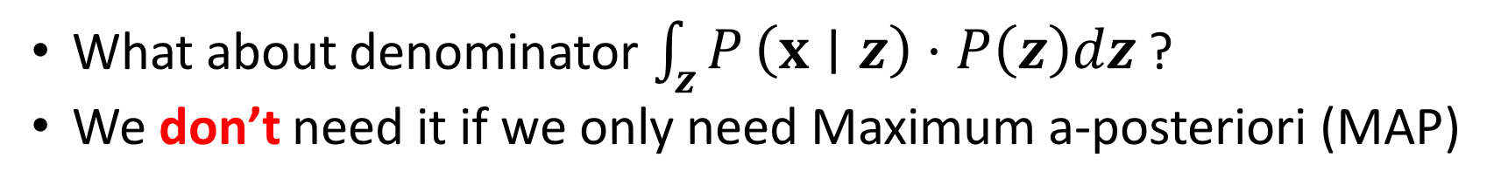
Recall Bayes formula
$$P\left(z∣x\right)=\frac{P\left(x∣z\right)⋅P\left(z\right)}{\int_{z}{P}\left(x∣z\right)⋅P\left(z\right)dz}$$
What about denominator $\int_{z}{P}\left(x∣z\right)⋅P\left(z\right)dz$ ?
We don’t need it if we only need Maximum a-posteriori (MAP)

Slide 28
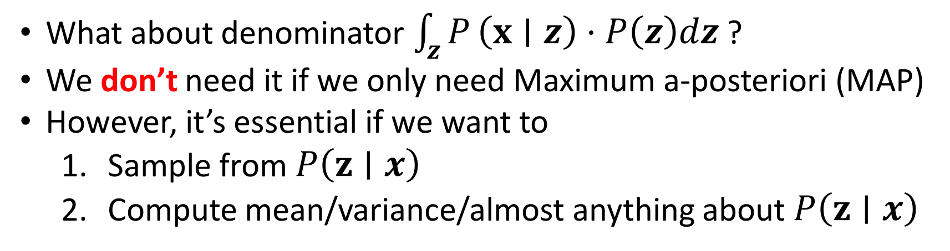
Recall Bayes formula
$$P\left(z∣x\right)=\frac{P\left(x∣z\right)⋅P\left(z\right)}{\int_{z}{P}\left(x∣z\right)⋅P\left(z\right)dz}$$
What about denominator $\int_{z}{P}\left(x∣z\right)⋅P\left(z\right)dz$ ?
We don’t need it if we only need Maximum a-posteriori (MAP)
However, it’s essential if we want to
Sample from $P\left(z∣x\right)$
Compute mean/variance/almost anything about $P\left(z∣x\right)$

Slide 29
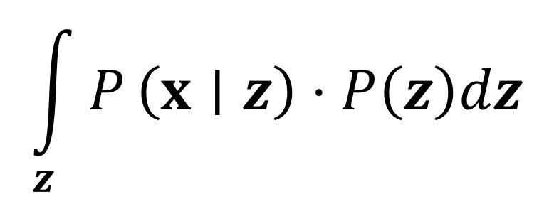
How to compute denominator?
$$\int_{z}{P}\left(x∣z\right)⋅P\left(z\right)dz$$
– ???

Slide 30
How to compute denominator?
$$\int_{z}{P}\left(x∣z\right)⋅P\left(z\right)dz$$
– ???
Analytically
+ Exact
– Works only in some cases

Slide 31
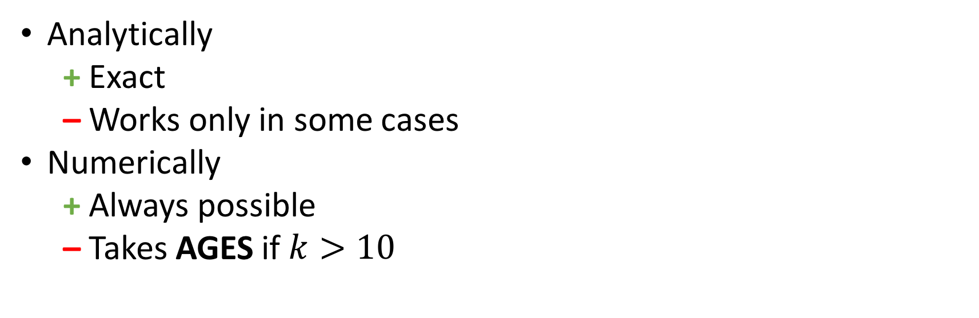
How to compute denominator?
$$\int_{z}{P}\left(x∣z\right)⋅P\left(z\right)dz$$
– ???
Analytically
+ Exact
– Works only in some cases
Numerically
+ Always possible
– Takes AGES if $k>10$

Slide 32

How to compute denominator?
$$\int_{z}{P}\left(x∣z\right)⋅P\left(z\right)dz$$
– ???
Analytically
+ Exact
– Works only in some cases
Numerically
+ Always possible
– Takes AGES if $k>10$

Slide 33
We can’t compute posterior…
$$\int_{z}{P}\left(x∣z\right)⋅P\left(z\right)dz$$

Slide 34
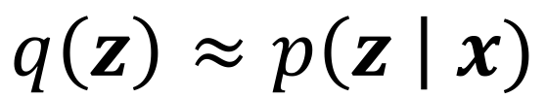
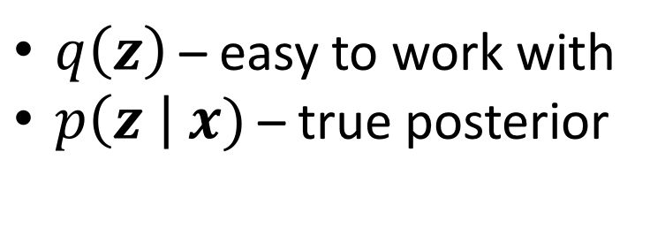
We can’t compute posterior… Approximate it!
$$\int_{z}{P}\left(x∣z\right)⋅P\left(z\right)dz$$
$$q\left(z\right)≈p\left(z \right| x)$$
$q\left(z\right)$ – easy to work with
$p\left(z \right| x)$ – true posterior

Slide 35
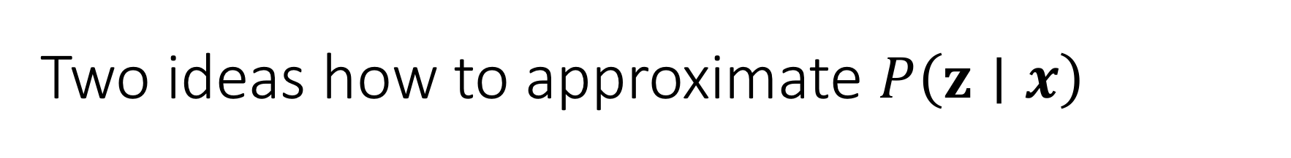
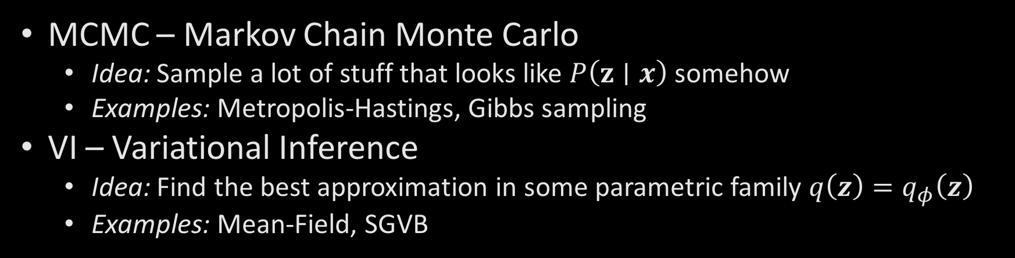
Two ideas how to approximate $P\left(z∣x\right)$
MCMC – Markov Chain Monte Carlo
Idea: Sample a lot of stuff that looks like $P\left(z∣x\right)$ somehow
Examples: Metropolis-Hastings, Gibbs sampling
VI – Variational Inference
Idea: Find the best approximation in some parametric family ${q\left(z\right)=q}_{φ}\left(z\right)$
Examples: Mean-Field, SGVB

Slide 36
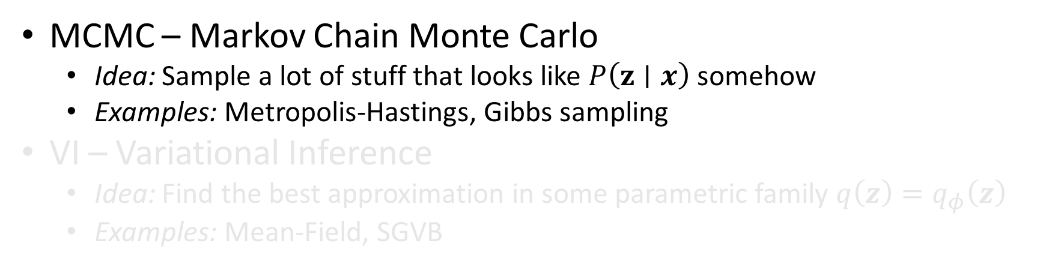
Two ideas how to approximate $P\left(z∣x\right)$
MCMC – Markov Chain Monte Carlo
Idea: Sample a lot of stuff that looks like $P\left(z∣x\right)$ somehow
Examples: Metropolis-Hastings, Gibbs sampling
VI – Variational Inference
Idea: Find the best approximation in some parametric family ${q\left(z\right)=q}_{φ}\left(z\right)$
Examples: Mean-Field, SGVB

Slide 37
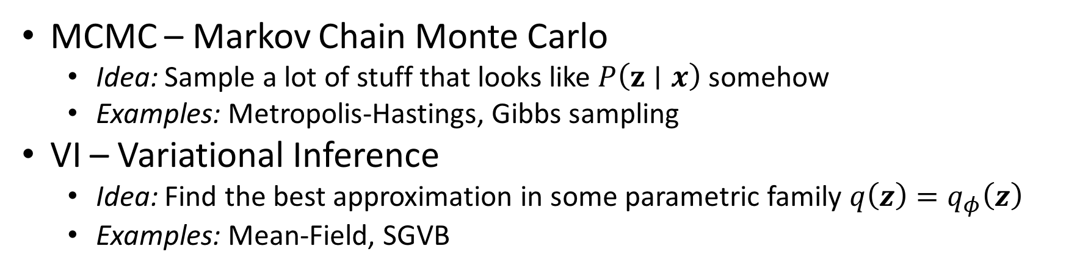
Two ideas how to approximate $P\left(z∣x\right)$
MCMC – Markov Chain Monte Carlo
Idea: Sample a lot of stuff that looks like $P\left(z∣x\right)$ somehow
Examples: Metropolis-Hastings, Gibbs sampling
VI – Variational Inference
Idea: Find the best approximation in some parametric family ${q\left(z\right)=q}_{φ}\left(z\right)$
Examples: Mean-Field, SGVB

Slide 38
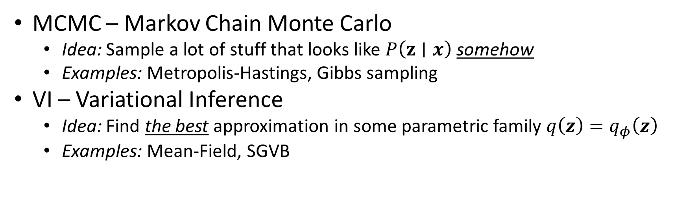
Two ideas how to approximate $P\left(z∣x\right)$
MCMC – Markov Chain Monte Carlo
Idea: Sample a lot of stuff that looks like $P\left(z∣x\right)$ somehow
Examples: Metropolis-Hastings, Gibbs sampling
VI – Variational Inference
Idea: Find the best approximation in some parametric family ${q\left(z\right)=q}_{φ}\left(z\right)$
Examples: Mean-Field, SGVB

Slide 39
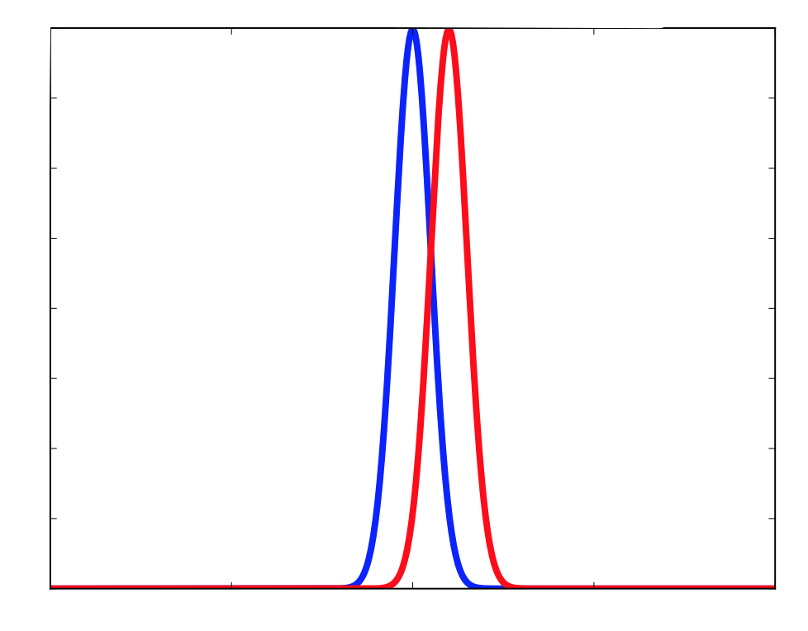
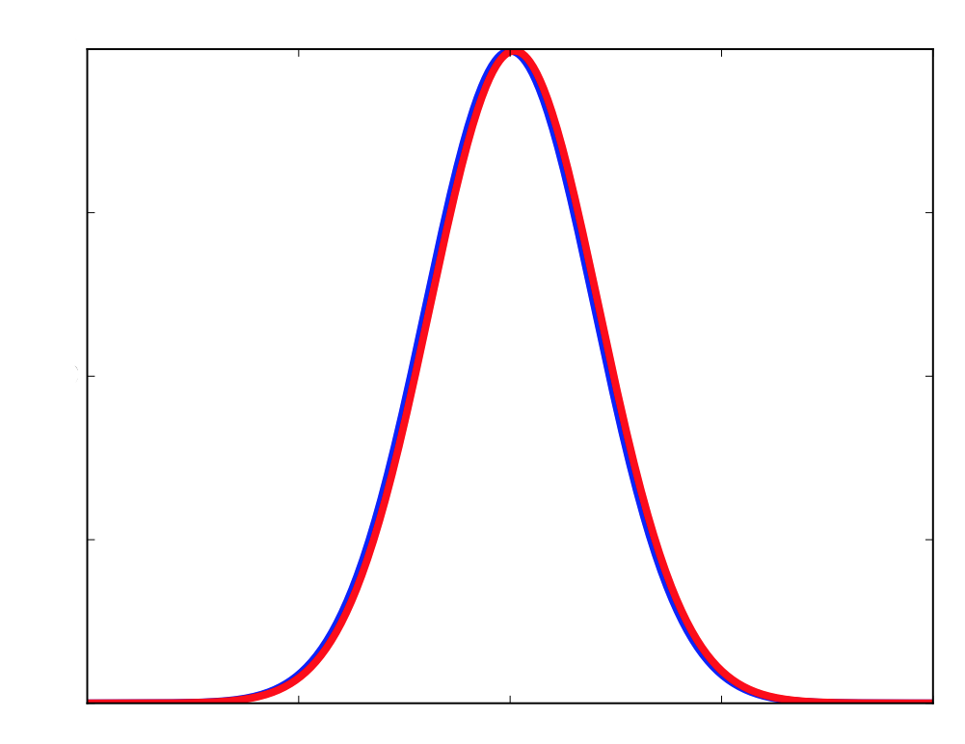
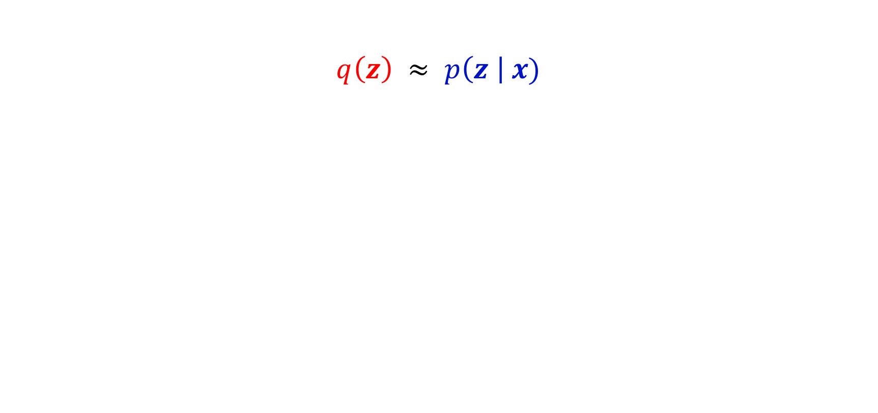
How to evaluate quality of approximation?
$$q\left(z\right) ≈ p\left(z \right| x)$$

Slide 40
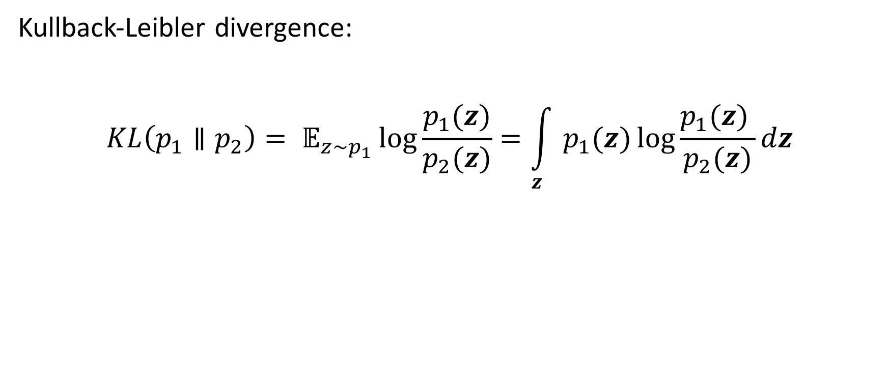
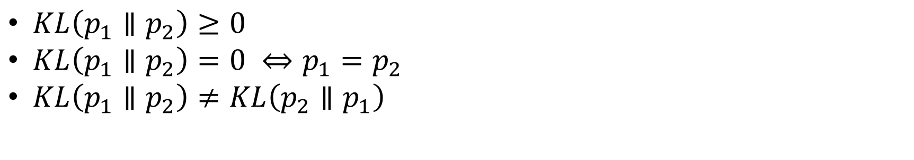
How to evaluate quality of approximation?
Kullback-Leibler divergence:
$$KL\left(p_{1}∥p_{2}\right)= 𝔼_{z\sim p_{1}}\log{\frac{p_{1}(z)}{p_{2}(z)}}=\int_{z}{p_{1}(z)\log{\frac{p_{1}(z) }{p_{2}(z)}}dz}$$
$KL\left(p_{1}∥p_{2}\right)≥0$
$KL\left(p_{1}∥p_{2}\right)=0 ⇔p_{1}=p_{2}$
$KL\left(p_{1}∥p_{2}\right)≠KL\left(p_{2}∥p_{1}\right)$

Slide 41
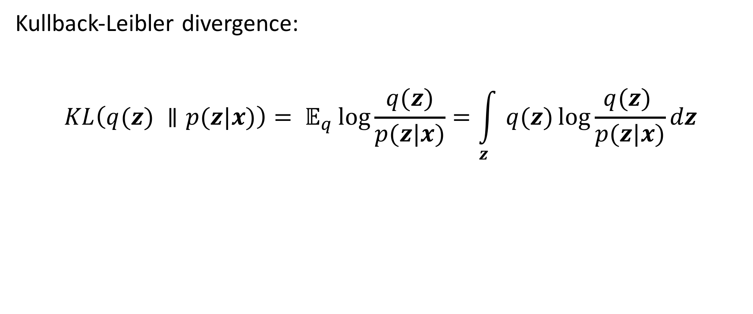
How to evaluate quality of approximation?
Kullback-Leibler divergence:
$$KL\left(q(z) ∥p(z|x)\right)= 𝔼_{q}\log{\frac{q(z)}{p(z|x)}}=\int_{z}{q(z)\log{\frac{q(z) }{p(z|x)}}dz}$$

Slide 42
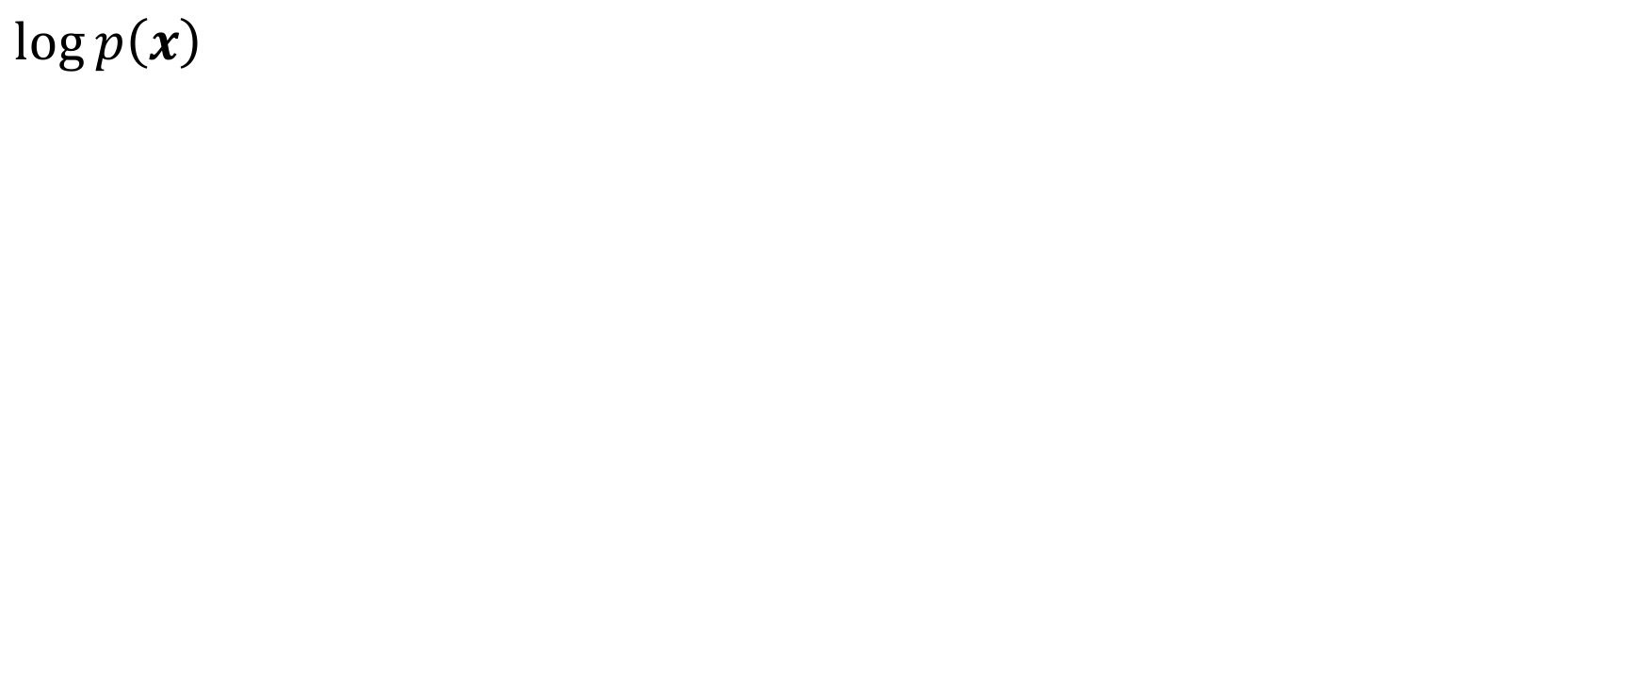
ELBO: Evidence Lower Bound
$$\log{p\left(x\right)}$$

Slide 43
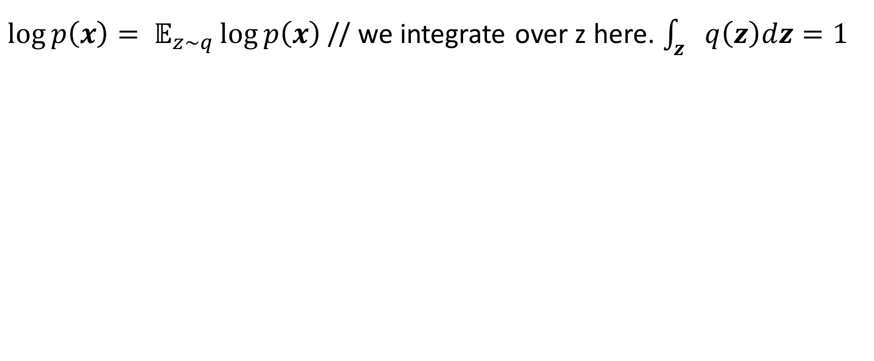
ELBO: Evidence Lower Bound
$\log{p\left(x\right)= 𝔼_{z\sim q}\log{p\left(x\right)}}$ // we integrate over z here. $\int_{z}{q\left(z\right)dz}=1$

Slide 44
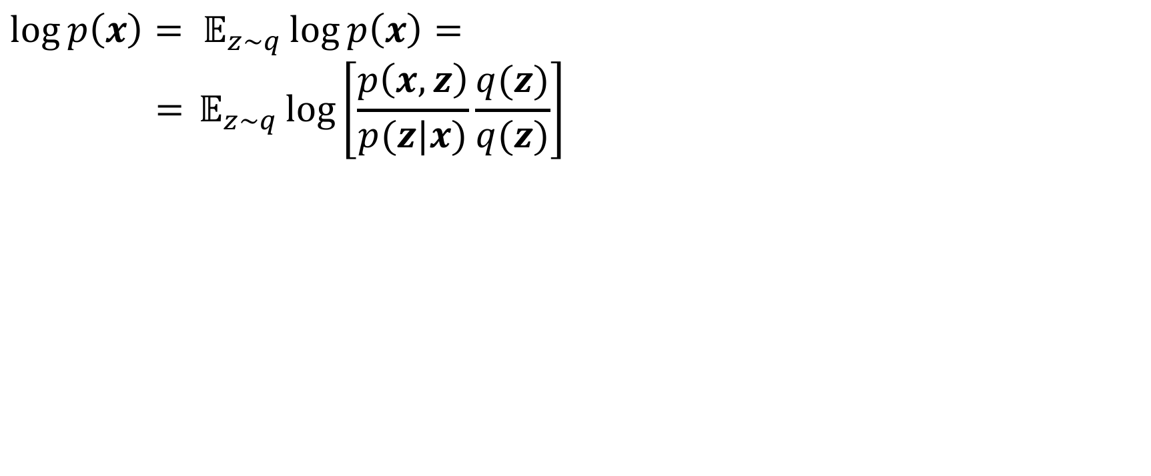
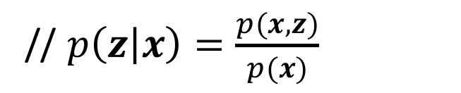
ELBO: Evidence Lower Bound
$$\log{p\left(x\right)= 𝔼_{z\sim q}\log{p\left(x\right)=}}$$
$$={𝔼_{z\sim q}log\left[\frac{p\left(x,z\right)}{p(z|x)}\frac{q(z)}{q(z)}\right]{}}$$
// $p\left(z | x\right)=\frac{p(x, z)}{p(x)}$

Slide 45
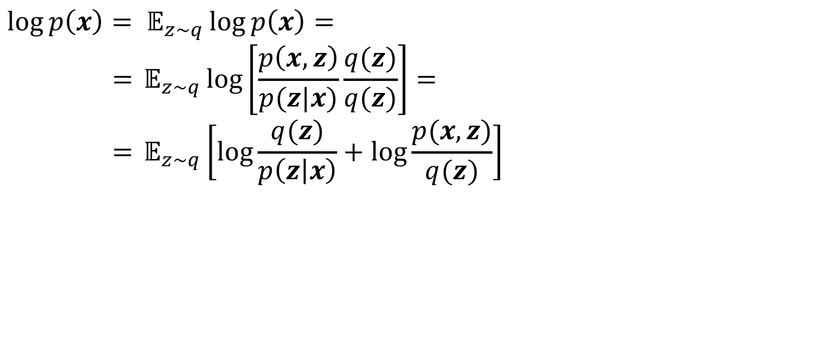
ELBO: Evidence Lower Bound
$$\log{p\left(x\right)= 𝔼_{z\sim q}\log{p\left(x\right)=}}$$
$$={𝔼_{z\sim q}log\left[\frac{p\left(x,z\right)}{p(z|x)}\frac{q(z)}{q(z)}\right]{=}}$$
$$={𝔼_{z\sim q}\left[log\frac{q(z)}{p\left(z | x\right)}+\log{\frac{p(x, z)}{q(z)}}\right]{}}$$

Slide 46
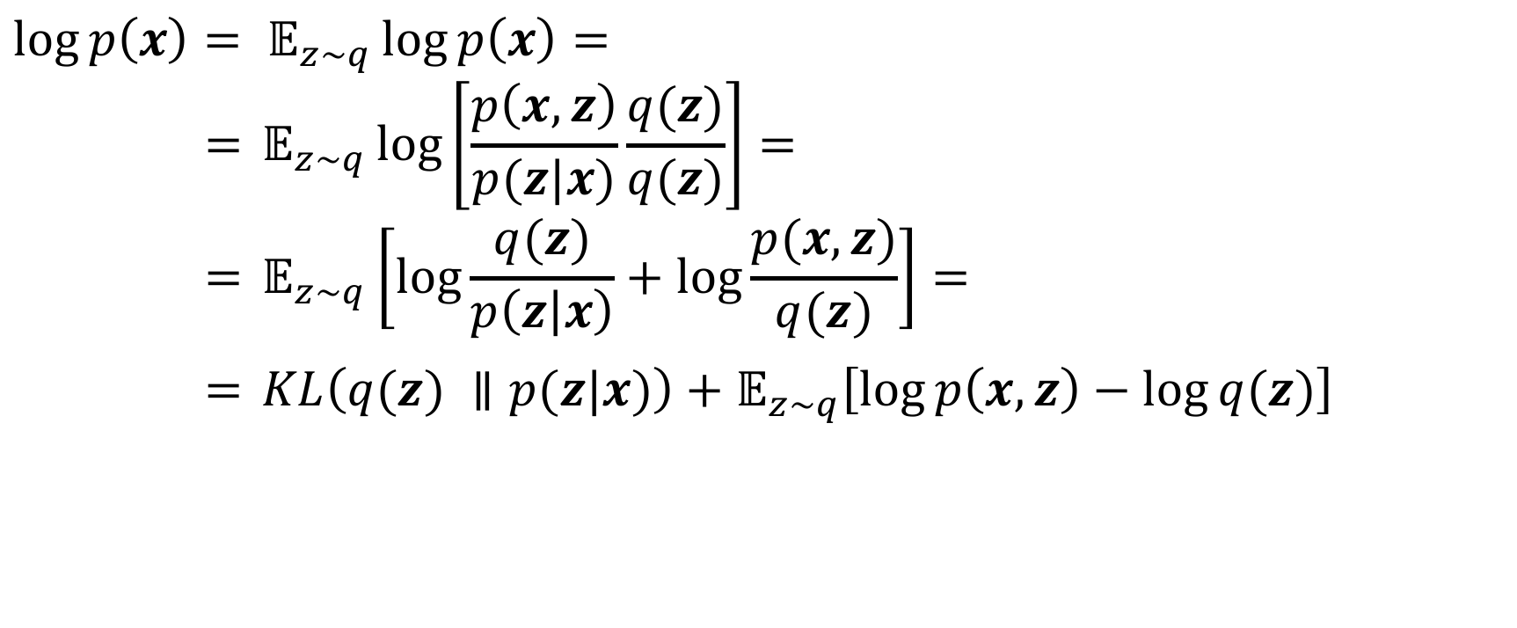
ELBO: Evidence Lower Bound
$$\log{p\left(x\right)= 𝔼_{z\sim q}\log{p\left(x\right)=}}$$
$$={𝔼_{z\sim q}log\left[\frac{p\left(x,z\right)}{p(z|x)}\frac{q(z)}{q(z)}\right]{=}}$$
$$={𝔼_{z\sim q}\left[log\frac{q(z)}{p\left(z | x\right)}+\log{\frac{p(x, z)}{q(z)}}\right]{=}}$$
$={{KL\left(q(z) ∥p(z|x)\right)+𝔼}_{z\sim q}\left[\log{p\left(x, z\right)}−\log{q(z)}\right]}$

Slide 47

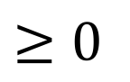
ELBO: Evidence Lower Bound
$$\log{p\left(x\right)= 𝔼_{z\sim q}\log{p\left(x\right)=}}$$
$$={𝔼_{z\sim q}log\left[\frac{p\left(x,z\right)}{p(z|x)}\frac{q(z)}{q(z)}\right]{=}}$$
$$={𝔼_{z\sim q}\left[log\frac{q(z)}{p\left(z | x\right)}+\log{\frac{p(x, z)}{q(z)}}\right]{=}}$$
$={{KL\left(q(z) ∥p(z|x)\right)+𝔼}_{z\sim q}\left[\log{p\left(x, z\right)}−\log{q(z)}\right]}$
$$≥0$$
$$ℒ(q)$$

Slide 48
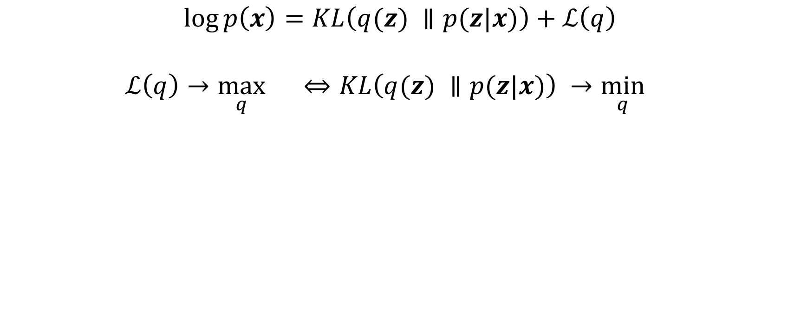
ELBO: Evidence Lower Bound
$$\log{p\left(x\right)}=KL\left(q(z) ∥p(z|x)\right)+ℒ\left(q\right)$$
$$ℒ\left(q\right)→\max_{q}{}⇔KL\left(q(z) ∥p(z|x)\right) →\min_{q}{}$$

Slide 49
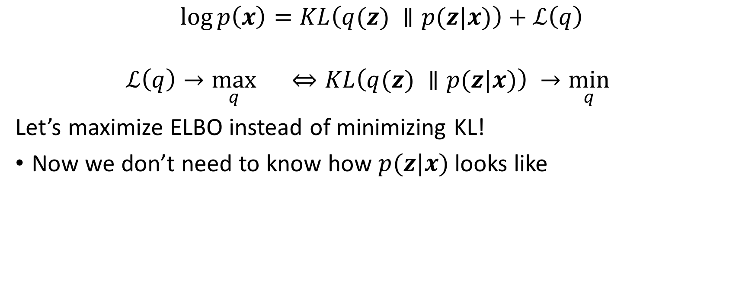
ELBO: Evidence Lower Bound
$$\log{p\left(x\right)}=KL\left(q(z) ∥p(z|x)\right)+ℒ\left(q\right)$$
$$ℒ\left(q\right)→\max_{q}{}⇔KL\left(q(z) ∥p(z|x)\right) →\min_{q}{}$$
Let’s maximize ELBO instead of minimizing KL!
Now we don’t need to know how $p(z|x)$ looks like

Slide 50
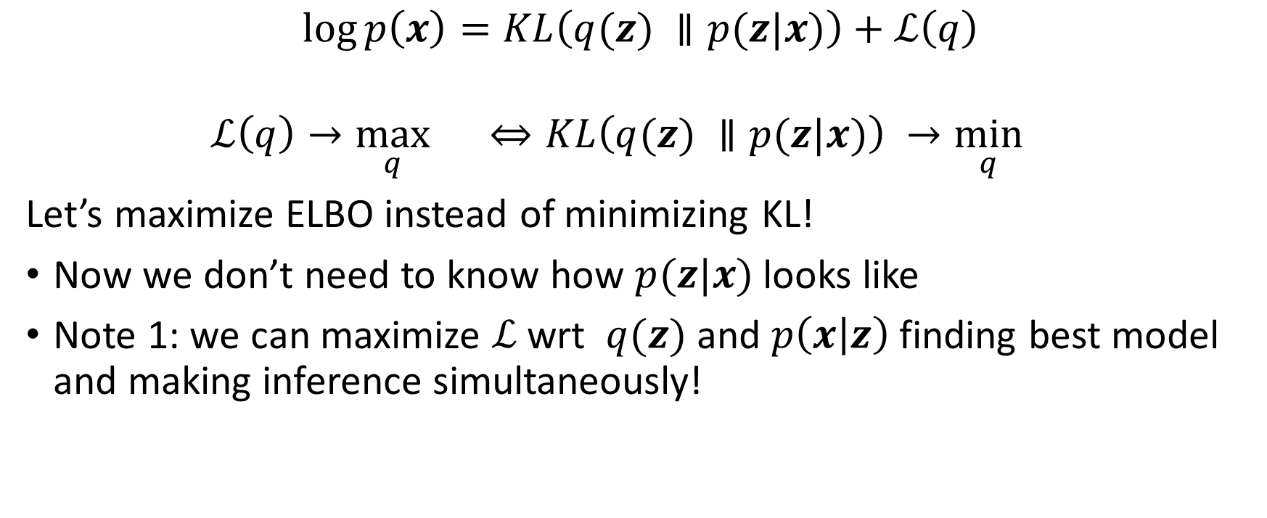
ELBO: Evidence Lower Bound
$$\log{p\left(x\right)}=KL\left(q(z) ∥p(z|x)\right)+ℒ\left(q\right)$$
$$ℒ\left(q\right)→\max_{q}{}⇔KL\left(q(z) ∥p(z|x)\right) →\min_{q}{}$$
Let’s maximize ELBO instead of minimizing KL!
Now we don’t need to know how $p(z|x)$ looks like
Note 1: we can maximize $ℒ$ wrt $q(z)$ and $p\left(x | z\right)$ finding best model and making inference simultaneously!

Slide 51
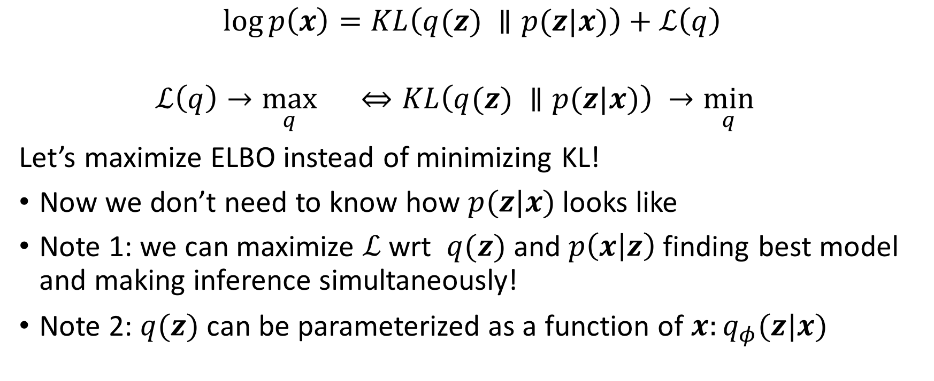
ELBO: Evidence Lower Bound
$$\log{p\left(x\right)}=KL\left(q(z) ∥p(z|x)\right)+ℒ\left(q\right)$$
$$ℒ\left(q\right)→\max_{q}{}⇔KL\left(q(z) ∥p(z|x)\right) →\min_{q}{}$$
Let’s maximize ELBO instead of minimizing KL!
Now we don’t need to know how $p(z|x)$ looks like
Note 1: we can maximize $ℒ$ wrt $q(z)$ and $p\left(x | z\right)$ finding best model and making inference simultaneously!
Note 2: $q(z)$ can be parameterized as a function of $x:q_{φ}(z|x)$

Slide 52
Variational Autoencoder

Slide 53
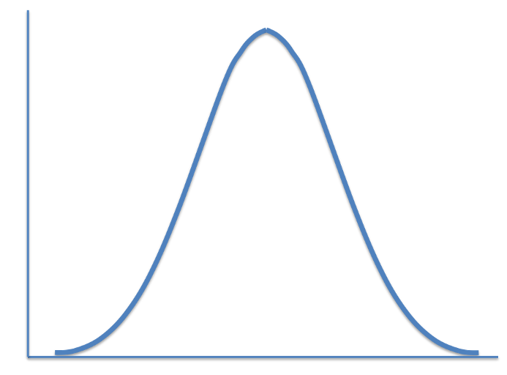
Variational Autoencoder

Slide 54
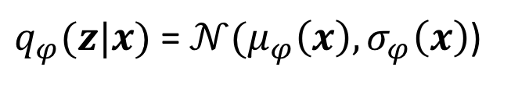
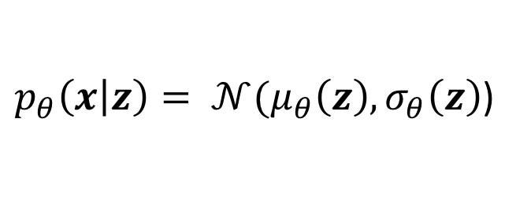
Variational Autoencoder
$q_{φ}(z|x)$ = $𝒩(μ_{φ}\left(x\right), σ_{φ}\left(x\right)$)
$p_{θ}\left(x | z\right)= 𝒩(μ_{θ}\left(z\right), σ_{θ}\left(z\right)$)

Slide 55
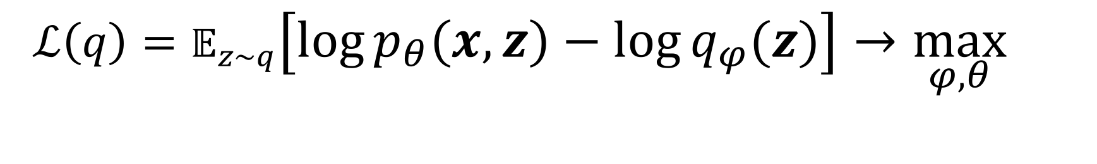
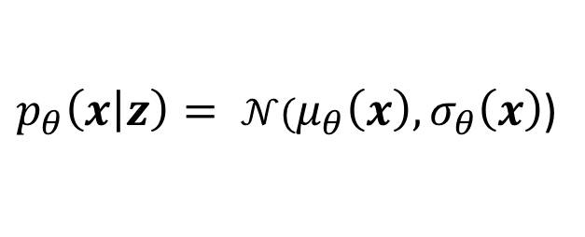
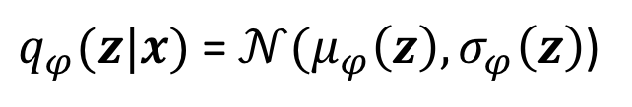
$$ℒ\left(q\right)=𝔼_{z\sim q}\left[\log{p_{θ}\left(x, z\right)}−\log{q_{φ}(z)}\right]→\max_{φ,θ}{}$$
$q_{φ}(z|x)$ = $𝒩(μ_{φ}\left(z\right), σ_{φ}\left(z\right)$)
$p_{θ}\left(x | z\right)= 𝒩(μ_{θ}\left(x\right), σ_{θ}\left(x\right)$)

Slide 56

$$ℒ\left(q\right)=𝔼_{z\sim q}\left[\log{p_{θ}\left(x, z\right)}−\log{q_{φ}(z|x)}\right]→\max_{φ,θ}{}$$
$ℒ\left(q\right)=𝔼_{z\sim q}\left[\log{p_{θ}\left(x|z\right)+\log{p_{θ}\left(z\right)}}−\log{q_{φ}(z|x)}\right]$
$q_{φ}(z|x)$ = $𝒩(μ_{φ}\left(z\right), σ_{φ}\left(z\right)$)
$p_{θ}\left(x | z\right)= 𝒩(μ_{θ}\left(x\right), σ_{θ}\left(x\right)$)

Slide 57

$$ℒ\left(q\right)=𝔼_{z\sim q}\left[\log{p_{θ}\left(x, z\right)}−\log{q_{φ}(z|x)}\right]→\max_{φ,θ}{}$$
$$ℒ\left(q\right)=𝔼_{z\sim q}\left[\log{p_{θ}\left(x|z\right)+\log{p_{θ}\left(z\right)}}−\log{q_{φ}(z|x)}\right]=$$
$=𝔼_{z\sim q}\left[\log{p_{θ}\left(x|z\right)}\right]−𝔼_{z\sim q}\left[\log{q_{φ}\left(z | x\right)} −\log{p_{θ}\left(z\right)}\right]$
$q_{φ}(z|x)$ = $𝒩(μ_{φ}\left(z\right), σ_{φ}\left(z\right)$)
$p_{θ}\left(x | z\right)= 𝒩(μ_{θ}\left(x\right), σ_{θ}\left(x\right)$)

Slide 58

$$ℒ\left(q\right)=𝔼_{z\sim q}\left[\log{p_{θ}\left(x, z\right)}−\log{q_{φ}(z|x)}\right]→\max_{φ,θ}{}$$
$$ℒ\left(q\right)=𝔼_{z\sim q}\left[\log{p_{θ}\left(x|z\right)+\log{p_{θ}\left(z\right)}}−\log{q_{φ}(z|x)}\right]=$$
$=𝔼_{z\sim q}\left[\log{p_{θ}\left(x|z\right)}\right]−𝔼_{z\sim q}\left[\log{q_{φ}\left(z | x\right)} −\log{p_{θ}\left(z\right)}\right]=$
$=𝔼_{z\sim q}\left[\log{p_{θ}\left(x|z\right)}\right]−KL\left(q_{φ}\left(z | x\right)∥p_{θ}\left(z\right)\right)$
$q_{φ}(z|x)$ = $𝒩(μ_{φ}\left(z\right), σ_{φ}\left(z\right)$)
$p_{θ}\left(x | z\right)= 𝒩(μ_{θ}\left(x\right), σ_{θ}\left(x\right)$)

Slide 59

$$ℒ\left(q\right)=𝔼_{z\sim q}\left[\log{p_{θ}\left(x, z\right)}−\log{q_{φ}(z|x)}\right]→\max_{φ,θ}{}$$
$$ℒ\left(q\right)=𝔼_{z\sim q}\left[\log{p_{θ}\left(x|z\right)+\log{p_{θ}\left(z\right)}}−\log{q_{φ}(z|x)}\right]=$$
$=𝔼_{z\sim q}\left[\log{p_{θ}\left(x|z\right)}\right]−𝔼_{z\sim q}\left[\log{q_{φ}\left(z | x\right)} −\log{p_{θ}\left(z\right)}\right]=$
$=𝔼_{z\sim q}\left[\log{p_{θ}\left(x|z\right)}\right]−KL\left(q_{φ}\left(z | x\right)∥p_{θ}\left(z\right)\right)→\max_{φ,θ}{}$
$q_{φ}(z|x)$ = $𝒩(μ_{φ}\left(z\right), σ_{φ}\left(z\right)$)
$p_{θ}\left(x | z\right)= 𝒩(μ_{θ}\left(x\right), σ_{θ}\left(x\right)$)

Slide 60
$$ℒ\left(q\right)=𝔼_{z\sim q}\left[\log{p_{θ}\left(x, z\right)}−\log{q_{φ}(z|x)}\right]→\max_{φ,θ}{}$$
$$ℒ\left(q\right)=𝔼_{z\sim q}\left[\log{p_{θ}\left(x|z\right)+\log{p_{θ}\left(z\right)}}−\log{q_{φ}(z|x)}\right]=$$
$=𝔼_{z\sim q}\left[\log{p_{θ}\left(x|z\right)}\right]−𝔼_{z\sim q}\left[\log{q_{φ}\left(z | x\right)} −\log{p_{θ}\left(z\right)}\right]=$
$=𝔼_{z\sim q}\left[\log{p_{θ}\left(x|z\right)}\right]−KL\left(q_{φ}\left(z | x\right)∥p_{θ}\left(z\right)\right)→\max_{φ,θ}{}$
Reconstruction error
Regularization term
$q_{φ}(z|x)$ = $𝒩(μ_{φ}\left(z\right), σ_{φ}\left(z\right)$)
$p_{θ}\left(x | z\right)= 𝒩(μ_{θ}\left(x\right), σ_{θ}\left(x\right)$)

Slide 61

$$ℒ\left(φ,θ\right)=𝔼_{z\sim q}\left[\log{p_{θ}\left(x, z\right)}−\log{q_{φ}(z)}\right]→\max_{φ,θ}{}$$
Training algorithm:
Take batch of data x. Sample batch of gaussian noise $ε.$
Pass x through encoder to get $μ_{φ}\left(x\right), σ_{φ}\left(x\right)$.
$z=σ_{φ}\left(x\right)ε$ +$μ_{φ}\left(x\right)$
Pass $z$ through decoder to get $μ_{θ}\left(z\right), σ_{θ}\left(z\right)$
Compute and backpropagate estimate of loss $ℒ\left(φ,θ\right)$: $\log{p_{θ}\left(x, z\right)}−\log{q_{φ}\left(z\right)}$
Make gradient updates for decoder and encoder with your favourite SGD-like algorithm

Slide 62
Thank you for your attention!

